Slide 1

Real-Time Fraud Detection System
Explore an innovative real-time system to combat fraudulent activities and protect financial operations.

Slide 2




Problem Statement
Rising tide of sophisticated frauds
Real-time fraud detection challenges
Complex global banking ecosystem
Regulatory and compliance pressures
Fraudsters employ advanced techniques like synthetic identities and malware to evade detection, causing significant financial losses.
Existing fraud detection systems struggle to keep pace with the evolving tactics of fraudsters, resulting in delayed response times and increased risk exposure.
With operations spanning multiple regions and diverse customer segments, global banks face difficulties in implementing a unified, real-time fraud detection strategy.
Stringent regulations and compliance requirements demand robust fraud detection and prevention measures, adding complexity to the problem.
Addressing the pressing issue of real-time fraud detection is crucial for global banks to safeguard their operations, protect customer interests, and maintain regulatory compliance in an increasingly sophisticated threat landscape.

Slide 3
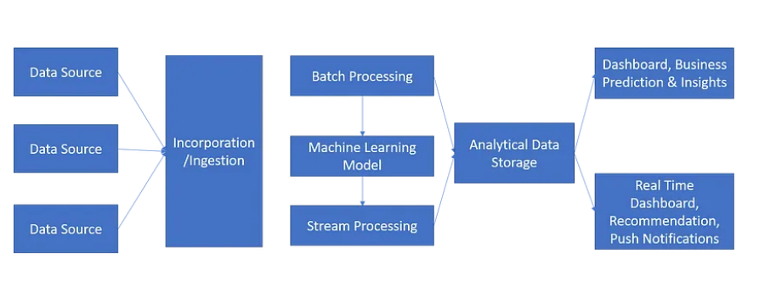
Proposed Data Flow
We present a prototype data flow architecture utilizing advanced big data technologies to facilitate real-time fraud detection for global banks.

Slide 4
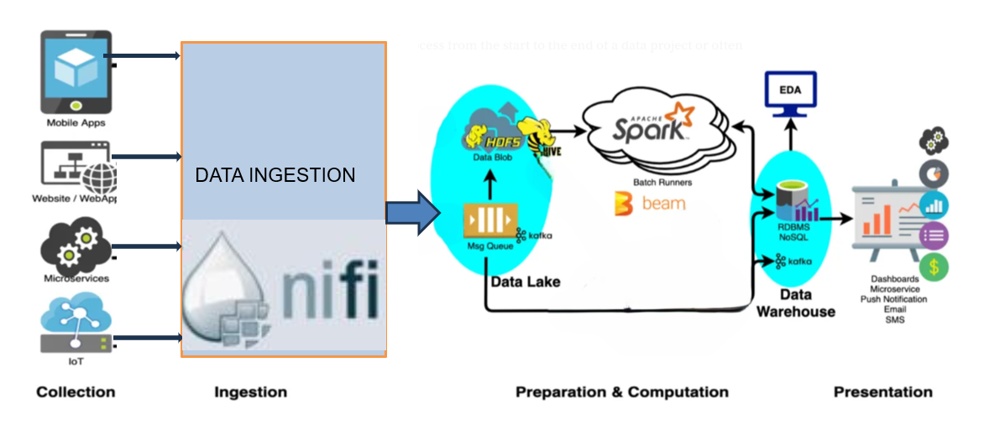
Proposed Architecture
we propose a comprehensive architecture that leverages the power of various big data tools. This architecture seamlessly integrates HDFS, YARN, Hive, HBase, Spark, Kafka, and NiFi, providing a robust and scalable solution for processing and analyzing large volumes of data.

Slide 5



High-Level Architecture Overview
Data Ingestion
Data Storage
Data Processing
Data Analytics
Data Streaming
Resource Management
Apache NiFi manages real-time data ingestion from databases, web services, IoT devices, ATMs, POS systems, and e-commerce platforms, ensuring reliable flow. Apache Kafka scales seamlessly, efficiently ingesting transactional data for fraud detection in the credit card solution
HDFS stores raw data like transaction logs and customer activities, leveraging scalability and fault tolerance. Apache HBase stores structured and semi-structured data such as user profiles and fraud alerts, ensuring low-latency access for real-time credit card fraud detection.
Apache Spark processes both batch and real-time data, enabling rapid fraud detection with its in-memory computing capabilities. Its multi-language support (Scala, Python, Java, R) facilitates the development of advanced fraud detection algorithms and machine learning models.
Apache Hive enables SQL-like queries to identify fraud patterns in large datasets. Apache Solr provides full-text search, quickly retrieving relevant information from unstructured data and customer communications for fraud investigations
Apache Kafka ingests real-time transaction data and feeds it to Apache Spark for fraud detection. It ensures continuous data flow, scalability, and fault-tolerance, handling high transaction volumes without downtime
Apache YARN will manage and allocate cluster resources, allowing multiple data processing engines Spark, and Hive, to share and efficiently utilize the available computing resources.

Slide 6




Data Flow and Real-time Analysis
Data Ingestion with Apache NiFi
Real-time Data Streaming with Apache Kafka
Real-time Fraud Detection with Apache Spark
Data Flow Visualization
NiFi facilitates the ingestion of data from various sources (e.g., payment gateways, transaction logs) into the real-time fraud detection system, ensuring smooth data flow.
Kafka acts as a distributed streaming platform, enabling the real-time ingestion and processing of data from NiFi. It provides a reliable and scalable messaging system for handling high-volume data streams.
Spark's real-time stream processing capabilities are leveraged to analyze the incoming data streams from Kafka. Machine learning models and rule-based algorithms are applied to detect fraudulent activities or suspicious patterns in near real-time.
A visual representation of the data flow, highlighting the interconnections between NiFi, Kafka, and Spark, showcasing how these tools work together to enable real-time fraud detection for global banks.

Slide 7
Data Management and Advanced Analysis
Hadoop Distributed File System (HDFS)
Apache Hive
HDFS stores and manages large amounts of transaction data across multiple nodes, enabling fast and reliable fraud detection. It helps identify patterns and anomalies in real time, allowing for swift action to prevent fraudulent activity.
Hive is a powerful tool for fraud detection, built on top of Hadoop. It allows for easy querying and analysis of large transactional datasets, helping to identify and prevent fraudulent activity.
Apache HBase
Apache Solr
HBase is a NoSQL distributed database built on top of HDFS, designed for low-latency random access and real-time read/write operations on large datasets, making it ideal for storing and retrieving transactional data for fraud detection.
Solr is a fast and powerful search engine that helps uncover fraud patterns in transactional data. It provides advanced search capabilities, including full-text search and faceted search, to quickly identify and analyze suspicious activity..

Slide 8






Real-Time Alerts and Notifications
1
Continuous data monitoring and analysis
2
Pattern recognition and anomaly detection
3
Automated rule-based triggering of alerts
4
Instant notification delivery via multiple channels
5
Real-time dashboard for alert visualization
6
Integrated case management and investigation

Slide 9


Benefits and Conclusion
Mitigate fraud risks
Enhance customer trust
Ensure compliance
Protect financial assets
Real-time fraud detection proactively identifies suspicious transactions, reducing financial losses.
Robust fraud prevention measures instill confidence in customers, fostering long-term loyalty.
Automated fraud detection helps banks comply with regulatory requirements and avoid penalties.
By detecting and preventing fraud, the solution safeguards the bank's financial resources and reputation.
Implementing real-time fraud detection is crucial for global banks to safeguard their operations, customers, and assets in today's ever-evolving threat landscape.

Slide 10


